Slide 1
Out-of-order Execution Divider
Sanmukh Kuppannagari

Slide 2
Overview
Concept of “In-Order” dispatch, “Out-of-Order” execution and “In-Order” Commit
Role of Re-Order Buffer (ROB) in facilitating OoE-IoC.
Performance improvement by using OoE technique

Slide 3
Problem Statement
Given dividend-divisor pairs as input, using 4 dividers in parallel, produce the quotient-remainder pairs under the following constraint:
“The order in which quotient-remainder pairs are deposited should be the order in which the dividend-divisor pairs are dispatched”

Slide 4
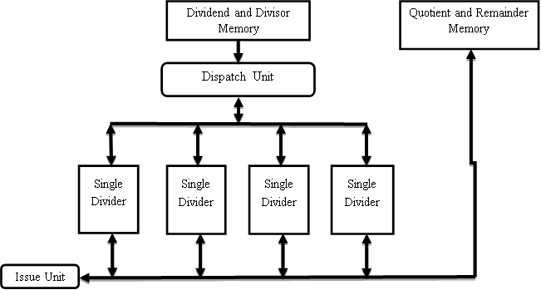
Part 1 Design

Slide 5
Part 1 Design
Definitions
Next Divider to be assigned: If previously divider $i$ was assigned, assign to divider $\left(i+1\right)mod 4$
Next Divider to be collected: If previously divider $j$ was collected, collect from divider $\left(j+1\right)mod 4$
Dispatch Unit
Wait until the next divider to be assigned is available and read the dividend-divisor pairs if all of the input memory is not read yet
Assign the pair to the next divider to be assigned and send a start signal
If the next divider to be assigned is executing, wait till it becomes available
Issue Unit
If the next divider to be collected has completed, collect the quotient-remainder pair and store it into the output memory
If the next divider to be collected has not yet completed, wait till it completes

Slide 6
Mem_dividend_divisor
24
4
15
7
15
5
5
4
Assign Pointer
Assign Pointer
Clock: 10
Clock: 11
Clock: 13
Clock: 14
Clock: 12
Clock: 0
Clock: 1
Clock: 2
Clock: 3
Clock: 4
Clock: 6
Clock: 7
Clock: 8
Clock: 9
Clock: 5
Dd = 24
Dr = 4
Q = 0
R = 24
Dd = x
Dr = x
Q = x
R = x
Ready
Dd = 20
Dr = 4
Q = 1
R = 20
Dd = 16
Dr = 4
Q = 2
R = 16
Dd = 12
Dr = 4
Q = 4
R = 12
Dd = 15
Dr = 5
Q = 0
R = 15
Dd = 10
Dr = 5
Q = 1
R = 10
Dd = 8
Dr = 4
Q = 4
R = 8
Dd = 4
Dr = 4
Q = 5
R = 4
Dd = 0
Dr = 4
Q = 6
R = 0
Dd = 5
Dr = 5
Q = 2
R = 5
Dd = 0
Dr = 5
Q = 3
R = 0
Dd = x
Dr = x
Q = x
R = x
Dd = x
Dr = x
Q = x
R = x
Dd = x
Dr = x
Q = x
R = x
Dd = 15
Dr = 7
Q = 0
R = 15
Dd = 8
Dr = 7
Q = 1
R = 0
Dd = 1
Dr = 7
Q = 2
R = 1
Dd = 1
Dr = 7
Q = 2
R = 1
Dd = x
Dr = x
Q = x
R = x
Dd = 1
Dr = 7
Q = 2
R = 1
Dd = x
Dr = x
Q = x
R = x
Dd = 5
Dr = 4
Q = 0
R = 5
Ready
Dd = 1
Dr = 4
Q = 1
R = 1
6
0
3
0
2
1
1
1
Busy
Busy
Done
Done
Collection Pointer
Collection Pointer
Mem_quotient_remainder

Slide 7
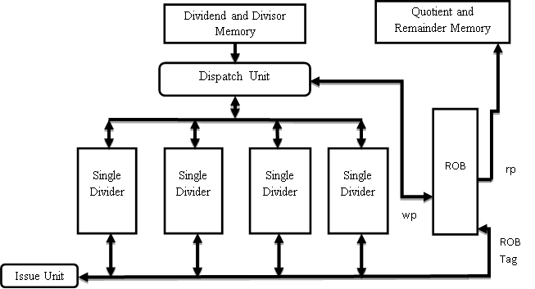
Part 2 Design

Slide 8
Part 2 Design
Introduce ROB to store the “out-of-order ”results produced by the dividers
Dispatch Unit
Wait until atleast one single divider is available and then read the dividend-divisor pair from the input memory if all of the memory is not read yet
Assign the dividend-divisor pair to the available divider in priority order i.e. if a divider with smaller index is available, the input is dispatched to it
Provide the write pointer of the ROB as a tag to the divider and increment the write pointer and send a start signal to the divider
The ROB tag will be used to store the result in the corresponding ROB location on collection
Issue Unit
If any divisor has completed, store the result into the ROB location corresponding to the ROB tag in the single divider

Slide 9
Part 2 Design
ROB
Write Pointer: Next free location, used by dispatch unit to allocate a ROB entry
Read Pointer: The top of ROB, entry corresponding to the most senior dispatched dividend-divisor pair
Issue unit can write at any location pointed by ROB tag
Wait until the top of ROB is not finished, once it is done store it into the output memory and increment rp

Slide 10
Mem_dividend_divisor
24
4
15
7
15
5
5
4
Clock: 10
Clock: 11
Clock: 0
Clock: 1
Clock: 2
Clock: 3
Clock: 4
Clock: 6
Clock: 7
Clock: 8
Clock: 9
Clock: 5
Clock: 12
WP
6
0
RP
3
0
Ready
Dd = 24
Dr = 4
Q = 0
R = 24
Ready
Dd = 20
Dr = 4
Q = 1
R = 20
Dd = 16
Dr = 4
Q = 2
R = 16
Dd = 12
Dr = 4
Q = 4
R = 12
Dd = 8
Dr = 4
Q = 4
R = 8
Dd = 4
Dr = 4
Q = 5
R = 4
Dd = 0
Dr = 4
Q = 6
R = 0
Dd = 5
Dr = 4
Q = 0
R = 5
Dd = 1
Dr = 4
Q = 1
R = 1
Dd = x
Dr = x
Q = x
R = x
Dd = x
Dr = x
Q = x
R = x
Dd = 15
Dr = 7
Q = 0
R = 15
Dd = 15
Dr = 5
Q = 0
R = 15
Dd = 10
Dr = 5
Q = 1
R = 10
Dd = 8
Dr = 7
Q = 1
R = 0
Dd = 1
Dr = 7
Q = 2
R = 1
Dd = 5
Dr = 5
Q = 2
R = 5
Dd = 0
Dr = 5
Q = 3
R = 0
Dd = x
Dr = x
Q = x
R = x
Dd = x
Dr = x
Q = x
R = x
Dd = x
Dr = x
Q = x
R = x
6
0
1
1
2
1
Busy
3
0
Busy
2
1
Done
WP
1
1
RP
Done
WP
RP
Mem_quotient_remainder
WP
RP
ROB

